Slide 1
Starting out training
Module 6 – Carer support and advocacy

Slide 2
Acknowledgement of Country

Slide 3
Content disclaimer
Please note that some content discussed during this module may be challenging.
We acknowledge that it may be difficult to engage with this content, and encourage you to care for your safety and well-being.
If the content covered today brings up any distress or discomfort for you, we encourage you to seek assistance through your foster and kinship care support worker or Child Safety.

Slide 4
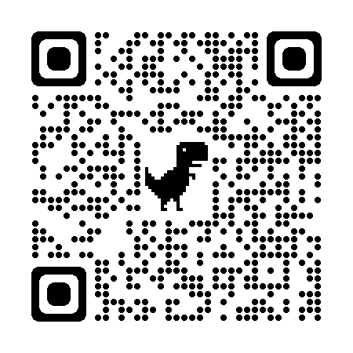
Acknowledgement
This module has been created in partnership with Queensland Foster and Kinship Care (QFKC).
QFKC are the peak body for informing, supporting, representing and advocating for carers and the children and young people for whom they care for.
For more information on QFKC please scan the QR code or visit: https://www.qfkc.com.au

Slide 5
Learning outcomes
Roles, rights and responsibilities of the care team
Your role as an advocate
Advocacy tools available to you
Vicarious trauma – how to manage
Grief and loss
How to raise your complaints
Where to go for support

Slide 6
Statement of Commitment

Slide 7
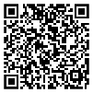
The Statement of Commitment
The Statement of Commitment is a formal commitment between the State and key stakeholders that includes the provision of support and resources to foster and kinship carers (carers).
This commitment has authority under the Child Protection Act 1999 (7i) and is founded on collaboration to ensure the safety, wellbeing and sense of belonging for children in care.

Slide 8
The Origins of the Statement of Commitment
The Statement of Commitment was originally developed in 2002
There have been 3 versions of the Statement of Commitment since this time but the most recent version signed off by Child Safety and peak bodies in 2020, represents a modern and contemporary document that can provide a platform for care team members to understand roles, rights and responsibilities for carers and key stakeholders.

Slide 9
Framework
The Statement of Commitment is underpinned by Principles that are consistent with the overall legislative framework in which Child Protection is delivered in Queensland such as:
Paramount Principle
Charter of Rights
Statement of Standards
Five elements of the Aboriginal and Torres Strait Islander Child Placement Principle (ATSCPP)
Human Rights Act 2019
Child and young person’s participation in decisions
Kin as first option for care arrangement

Slide 10
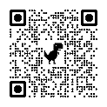
Principles
In addition to the legislative framework, additional Principles have been included as follows:
The Statement will be consistent with
‘Our Way: a generational strategy for
Aboriginal and Torres Strait Islander
children and families’.
Carers will receive and should expect support that will help them provide a safe and caring environment in which the needs of children and young people are met.
Carers will be respected and recognised as having significant relationships with the children and young people in their care.
As members of a child or young person’s safety and support network and care team, all participants will be treated fairly and equally with courtesy, respect and personal dignity and will be recognised for their unique knowledge and contributions to safety and case planning.

Slide 11
Platform for discussion
The Statement of Commitment is a critical tool that provides shared understanding and therefore a platform for discussion around the critical roles each partner plays in the care of children and young people.
This document can also provide a safe space for partners to observe accountability – it provides a clear and consistent message to all key partners, regardless of the demographic in Queensland, as to how we work together to keep children and young people safe in family-based care.
Each component of the Statement is critical, rights are not without responsibilities and every partner should have a shared understanding of each other’s roles.

Slide 12
Activity
We will now consider some everyday carer experiences where having knowledge and understanding of the Statement of Commitment will empower you to advocate for both yourself and the children and young people you provide care to.

Slide 13
What is great about the Statement of Commitment is that it is genuinely reflective of the care team approach – it recognises that everyone has a role to play in the lives of children and young people and it sets out what these roles are.
We have explored through scenarios the role of carers within the child protection system and now it is time to explore the role of two other critical care team members:
Child Safety and
the foster and kinship care agency.

Slide 14
Child Safety’s role
The overall role of Child Safety is to ensure the safety, belonging and wellbeing of children and young people. When this cannot be achieved safely with parents, Child Safety will place children and young people in a care environment that best meets their needs by:
Ensuring care is consistent with the Statement of Standards, Charter of Rights and Aboriginal and Torres Strait Islander Principles.
Consulting with children and young people and support them to participate in decisions affecting their lives.
Actively supporting and facilitating participation of Aboriginal and Torres Strait Islander families and communities in processes, decisions and actions about their safety and wellbeing of their children in accordance with the five elements of the Aboriginal and Torres Strait Islander Child Placement Principles.

Slide 15
Child Safety’s role continued….
Working with parents to address concerns, so that children and young peoples permanent care is, where possible, provided by their parents.
Ensuring that when reunification is not possible, concurrent planning allows for the child or young persons safety, belonging and wellbeing to be met through an alternative permanency option that meets the child’s legal relational, physical and cultural needs.
Working with non-government community-based foster and kinship care services to undertake the role of identifying recruitment, training and support of carers.
Ensuring placement needs and supports for children are clearly documented, updated and understood through case plans and care agreements.

Slide 16
Foster and kinship care agency role
Work with Child Safety to identify kinship carers, recruit foster carers and assess, train and support carers.
Involve carers in the planning and delivery of training, ensuring it is timely, relevant and culturally appropriate.
Advocate for carers needs and supports.
Respond to requests for placements from Child Safety in a timely manner to meet the needs of the child or young person.
Respond to carers requests for support in a timely manner to meet the needs of the child or young person.

Slide 17
Foster and kinship care agency role continued…
Work with Child Safety to assist and support carers to implement and achieve the agreed goals and outcomes of the child or young persons case plan.
Provide ongoing support for carers through a range of services and resources.
Work with Child Safety to provide access to training, both initial and ongoing.
Raise community awareness of the role of carers and encourage people who are interested to seek further information and make application.
Advocate for the importance of Aboriginal and Torres Strait Islander children to be placed with kin.
Advocate for Aboriginal and Torres Strait islander children to be connected to kin and the community.

Slide 18
Activity
Let’s Review
When considering the roles of Child Safety and the foster and kinship care services, we can now go back to the scenarios that we explored earlier and apply the roles of both Child Safety and the foster and kinship care service to these scenarios
Remember caring for children in a statutory system requires a care team approach and outlining everyone’s roles clearly supports this approach.

Slide 19
Statement of Commitment
Summary
No matter what scenario you find yourself in as a carer, the Statement of Commitment provides a platform for you to understand what your roles, rights and responsibilities are, and what the roles of key stakeholders are within the context of your situation.
This then allows you to approach advocacy in a way that relies on factual and considered information. It helps to take the emotion out of what can often complicate situations.
The Statement of Commitment should be placed in your toolbox as carers and relied upon to help you navigate the Child Protection system.
Remember, not all Stakeholders will be familiar with the Statement of Commitment, so you sharing your knowledge and experience of the Statement of Commitment with your care team, will help everyone to understand their roles, and experience a shared understanding and platform for discussion.

Slide 20
Human Rights Act 2019

Slide 21
Human Rights Act 2019
The Queensland Human Rights Act 2019 aims to protect and promote human rights and to help build a culture in the Queensland Public sector that respects and promotes human rights. The Human Rights Act 2019 intends to help promote a dialogue about the nature and meaning of human rights.
The Queensland Human Rights Commission acknowledges Aboriginal and Torres Strait Islander peoples as the First Australians and recognizes their culture, history, diversity and their deep connection to the land, waters and seas of Queensland and the Torres Strait.
(Introduction to the Queensland Human Rights Act 2019, Participant workbook)

Slide 22
The main objectives
To protect and promote human rights
To help build a culture in the Queensland public sector that respects and promotes human rights; and
To help promote a dialogue about the nature, meaning and scope of human rights.
The Act binds all persons and applies to:
Public entities;
Courts and tribunals; and
Queensland Parliament.

Slide 23
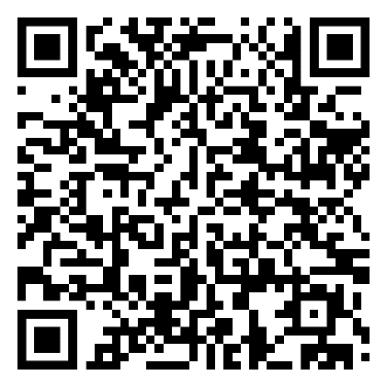
What rights are protected in the Qld Human Rights Act 2019
There are 23 Human Rights that are protected as per the Human Rights Act 2019 section 15 to section 37

Slide 24
Public Entities – what are they?
There are two types of public entities:
Core public entities are those that are considered public entities at all times, regardless of the functions they are performing i.e., a State government department, a public service employee and a Minister.
Functional public entities are those that are only considered entities when they are performing certain functions. The introduction of functional public entities reflects the modern operation of the government, where non-government entities, including non-government organisations, private companies and government owned corporations are engaged in various ways to deliver services to the public on behalf of the government or another public entity i.e., a private company managing a prison, a non-government organisation providing a public housing service.

Slide 25
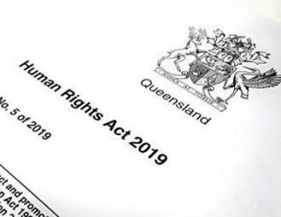
Carer responsibilities
As functional entities, carers have a responsibility to ensure that a child or young person’s human rights are being upheld.
When a carer is meeting the Statement of Standards and Charter of Rights for a child or young person in their care, they are effectively meeting their responsibilities under the Human Rights Act 2019 to the child or young person.

Slide 26
Activity
You will be provided with a list of the Rights as outlined in the Human Rights Act 2019 which provide detail about what each right means.
You will also be provided with a list of the Statement of Standards and Charter of Rights.
Now let's explore some scenarios in small groups …

Slide 27
Care team approach
Carers cannot meet the Statement of Standards and Charter of Rights in isolation, it takes a care team approach.
Therefore, to meet the Human Rights for children and young people, it also takes a care team approach.
Whilst carers have responsibilities to meet a child or young person’s human rights as functional public entities, Child Safety also play a role in meeting a child’s human rights as core entities.

Slide 28
Carer rights under the Human Rights Act 2019
Carers also have rights under the Human Rights Act 2019 – for example:
Section 20 – Freedom of thought, conscience, religion and belief
Section 21 – Freedom of expression
Section 25 – Privacy and reputation
Section 26 – Protection of families and children
Section 27 – Cultural rights –generally
Section 28 – Cultural rights – Aboriginal peoples and Torres Strait Islander peoples
The Statement of Commitment also supports many of these rights through commitments made by Child Safety to carers

Slide 29
When Human Rights are not being met
In the first instance, the complainant must attempt to resolve the complaint through the usual means available to them through the public entity – we will explore internal complaint process soon.
Only where a child or young person or carer does not believe they have been heard in their complaint would they then lodge a complaint with the Human Rights Commission.
If the complaint is accepted by the Commissioner, the process of resolution promotes a dialogue model – much like conciliation.
There is no financial compensation element to this model.

Slide 30
Complaint made to the public entity
How has the public entity responded to the complaint?
Public entity does not respond within 45 business days, or provides inadequate response.
Public entity provides adequate response within 45 business days
Complaint made to QHRA
Dialogue between complainant and public entity
Preliminary enquiries made by the Commissioner
Commissioner may decide to accept complaint for resolution (respondent notified)
Commissioner may attempt to resolve through conciliation
Flow chart of QHRA complaints process
Complaint resolved
Commissioner notifies all parties
Complaint unresolved
Commissioner must prepare a report and give to all parties

Slide 31
Public Entity reporting
Public entities identified under the Financial Accountability Act 2009 (this includes the Department of Children, Youth Justice and Multicultural Affairs) are required to produce an annual report and from 2020, this report will be required to include information relating to their compliance with the Human Rights Act 2019. This information will include:
Details for any actions taken during the reporting period to further the objects of the legislation;
Details of any human rights complaints received by the entity including number and outcomes; and
Details of any review of policies, programs, procedures, practices or services undertaken in relation to their compatibility with human rights.

Slide 32
Summary Human Rights Act 2019
Should be seen as a tool that can promote good advocacy for children and young people’s needs to be met and for children and young people and carers rights to be upheld.
The Human Rights Act 2019 will also provide for the protection of rights relating to families and therefore birth parents.
Important that on all occasions, all appropriate steps are taken to resolve the conflict as per the processes set out by the public entities that would already be in place i.e., complaints processes.
Only when these attempts have not been successful, should there be access to the Human Rights Commission.

Slide 33
Placement agreements

Slide 34
Placement agreements
Section 84 Child Protection Act 1999
Agreements to provide care for children:
If an approved carer agrees to care for the child, the chief executive and approved carer must enter into a written agreement for the child’s care.
Note - Provisions of the agreement may be included in the child’s case plan.
The terms prescribed under a regulation must be included in the agreement.

Slide 35
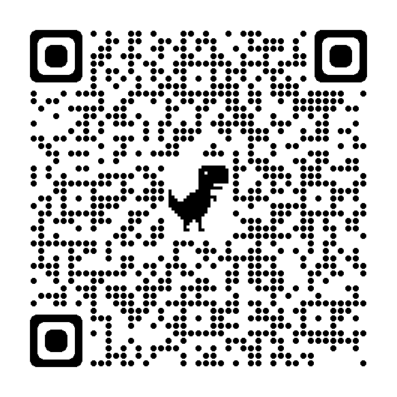
Purpose of Placement agreements (PA)
Provides those responsible for the child’s daily care with the most recent information about the child’s needs
Responds to the need for additional supports to meet the child’s needs or to assist those caring for the child to meet the child’s needs.
Reflects the changing family contact schedules and cultural contact arrangements.
Shares responsibility for meeting the child’s needs.
Helps the parties to be clear about their role and responsibilities, and that of others in the child’s safety and support network.
Placement agreements should be completed at least 6 monthly.
QR code = CSPM Support a care arrangement

Slide 36
If PAs are not completed…
Care team not understanding support needs of care arrangement i.e. respite/short break requirements, child care needs, etc.
Increased risk of care arrangement breakdown
No record of verbal agreements which can lead to miscommunication and ultimately care arrangement breakdown.
Sharing of information not occurring as it should leading to potential risk to other children in care arrangement and household members.
No clear expectations and understanding leading to increased phone traffic to CSSC.

Slide 37
If PAs are not completed continued...
Cultural and Religious needs not being met or understood by care team.
Health, Education and therapy needs not being met or understood by care team.
The Care team does not have the very document that is reviewed when it is found that Standards of Care have not been met for a child in care.
Essentially a care team is not meeting their overall goal of creating safety for a child by not completing a Placement agreement.

Slide 38
Support and training for approved carers

Slide 39
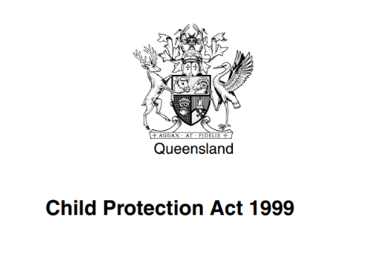
Chief executive’s responsibility to provide support and training
On May 21st, 2023, section 148E of the Child Protection Act 1999 was enacted which refers to the Chief Executive responsibility to carers to provide support and training
What does this mean for carers?

Slide 40
Section 148 E
The Chief executive must provide the approved carer with or ensure the approved carer has access to the following:
support to help the carer care for the child, including for example
information about financial assistance for approved carers
Information and advice about providing care for children
Respite care
access to support persons

Slide 41
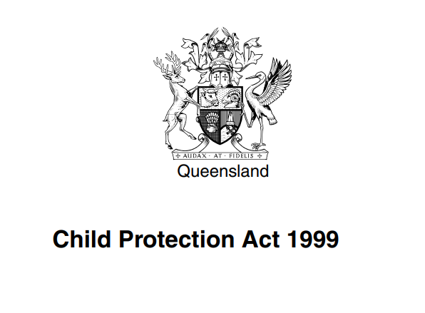
Section 148E continued…
Training programs that maintain or develop the carer’s ability to care for the children
The chief executive need only comply with subsection to the extent the chief executive considers that
It is practicable to do so and
The support or training is appropriate in the circumstances.

Slide 42
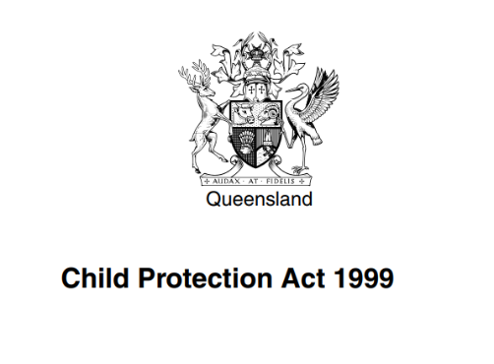
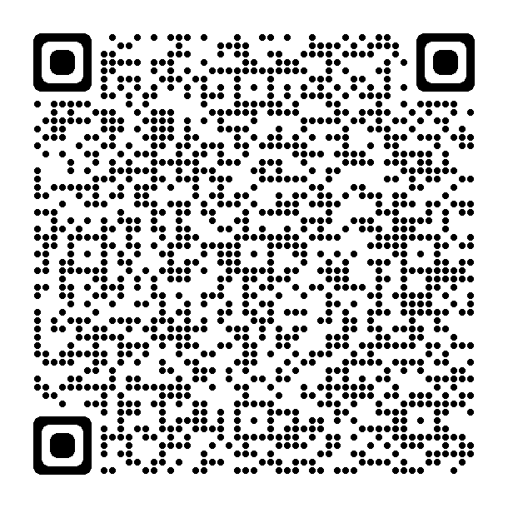
Section 148E continued…
QR code for more information on the changes to Queensland’s child protection laws

Slide 43
Complaints Management

Slide 44
Where does the Complaints unit sit
Child Safety Service Centres (CSSC)
Regions
Central Office
Brisbane and Moreton Bay
Far North Queensland
North Queensland
South East
South West
Sunshine Coast and Central
Complaints Unit
Information Privacy & Governance
Professional Standards
Information Access and Amendment
Child Safety After Hours
Central Screening Unit

Slide 45
Office of the Chief Practitioner (OCP) - Specialised Areas
Complaints Unit
Systems and Practice Review
Child Safety Training
Child Protection Practice
Domestic and family violence
Alcohol and other drugs
Disability
Mental health
Sexual and gender identity
Indigenous practice
Practice advice and support
Child Sexual abuse practice
NDIS Interface Team
Delegated Authority
Child Safety Practice Manual Team

Slide 46
Complaints Process | Overview
Complaint
First Attempt at Resolution
Formal Written Response
Local Early Resolution
If you remain dissatisfied after your FAAR or the CSSC has not responded to you within the FAAR timeframe, you can contact the Complaints Unit to escalate your concerns to a complaint. Complaints Unit may devolve your complaint.
The department encourages a local early resolution of your concerns. Contact your Child Safety Officer or Senior Team Leader in the first instance. If you are having trouble getting hold of them you can contact the Complaints Unit to raise a FAAR.
External Review
Internal Review
Queensland Ombudsman
Industrial Relations Commission
Qld Human Rights Commission
Information Commissioner Qld
Merit & Process Review
If you remain dissatisfied with the findings of your complaint (merit) or how your complaint was managed (process). You can request an Internal Review through the Complaints Unit
If you still remain dissatisfied you can pursue external review options.
Foster and kinship agencies
All funded agencies are required to have their own complaint management process, if you lodge a complaint through your agency and are not satisfied with the outcome, you can then lodge a complaint through the Child Safety Complaint’s unit.

Slide 47
Complaints Management – key points
Mode of complaints
Complaints can be made via phone, email or through the Complaints Unit feedback function via Child Safety website
Mandatory complaint training
All departmental staff are enrolled into complaints training
Complaints management policy and procedure
Driven by Policy and Procedure found on Child Safety’s website and updated 1st July 2022
Decision-maker level
Decision-maker is at the same level or higher than the decision-maker for the complaint
Timeframes
Simplified complaint and Internal Review timeframes to 45 days
Written findings letters
All complainants receive a written outcome letter which includes the findings for each allegation raised
Guiding Principles
Child Safety commits to guiding Principles in policy around complaints management

Slide 48
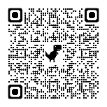
First Attempt at Resolution
Prior to a complaint process
Resolved at the point of service
Early resolution
Forms part of case work
Can have flexible responses and outcomes
A guide to making a complaint
QR code

Slide 49
Complaint
Occurs after a First Attempt at Resolution where applicable
The concerns are investigated by an appropriate officer
The complainant is provided a findings letter with the outcome of the investigation
The complainant is entitled to provide feedback in relation to the findings
The complainant is provided information on where to escalate their concerns if they remain dissatisfied

Slide 50
Internal Review
Internal Process Review
Internal Merit Review
Reviews the process of a finalised complaint e.g. you were not given the opportunity to provide feedback
Backwards facing
Focused on the complaint process
Investigates the original concerns raised
Forward facing
Solutions focused
Collaborative
May include a review of the previous complaint process

Slide 51
Complaint Management| Scenarios
Brooke, Kinship Carer
Pauline, Foster Carer
Phil, Kinship Carer

Slide 52
First Attempt at Resolution| Scenarios
First Attempt at Resolution (FAAR)
Phil is a Kinship Carer for Carl and his sister Bianca.
Phil wants to take the children on a holiday interstate next month. He emailed Carl and Bianca’s CSO about the trip to seek approval. Phil emails the CSO again a few days later when he has not received a reply. Phill phones the CSO few more days later when he still has not received a reply and is advised that the CSO is currently not available and takes his message.
Almost two weeks have passed since Phil’s initial email to the CSO. Phil is frustrated at the lack of response to his fast approaching holiday.
Local Early Resolution
Phil, Kinship Carer

Slide 53
Where?
First Attempt at Resolution (FAAR)
Local Early Resolution
There are a number of ways Phil might consider raising his concerns
First Attempt at Resolution| Scenarios
Phone the CSSC and ask to speak to a senior officer
First Attempt at Resolution| Scenarios
Phone the Regional Office and ask to raise a complaint with the complaints Senior Advisor
Phone, email or complete the online web form for the Complaints Unit
Talk to Carl and Bianca’s Community Visitor
Phone or email the Ministers Office
Phone or email the Queensland Ombudsman
Queensland Civil and Administrative Tribunal (QCAT)
Queensland Human Rights Commission

Slide 54
First Attempt at Resolution (FAAR)
The CU replies to the QO
Local Early Resolution
The CU checks the departments record keeping systems and 2 days later emails the QO advising Phil has not raised his concerns with the department
The QO Replies to the CU
2 days later, the QO emails CU to assess and progress Phil’s concerns
First Attempt at Resolution| Scenarios
First Attempt at Resolution| Scenarios
The QO emails the Complaints Unit (CU)
2 days later the QO emails the Complaints Unit to determine if Phil has raised his concerns with the department.
The CU assess Phil’s concerns
The advisor records Phil’s concerns and decides to progress them as a FAAR to try and get the issue resolved as quickly as possible
Phil phones the Queensland Ombudsman (QO)
The QO records Phil’s concerns. Phil advises the QO that he has raised his concerns previously with the department.
First Attempt at Resolution
9 working days to finalise
Local Early Resolution
Phil’s concerns are referred to the STL as a FAAR.
Phil receives a call the next day from the STL who apologises for the CSO failure to respond due to unexpected leave and arranges the paperwork and approval process.

Slide 55
First Attempt at Resolution (FAAR)
Local Early Resolution
First Attempt at Resolution
First Attempt at Resolution| Scenarios
Local Early Resolution
The next day Phil’s concerns are referred to the STL as a FAAR.
Phil received a call the following day from the STL who apologises for the CSO failure to respond due to unexpected leave and arranges the paperwork and approval process.
Phil phones the Complaints Unit
The advisor records Phil’s concerns and decides to progress Phil’s concerns as a FAAR to try and get the issue resolved as quickly as possible
2 working days to finalise

Slide 56
First Attempt at Resolution (FAAR)
Local Early Resolution
Pauline is a Foster Carer for Max.
Max recently came into Pauline’s care, Max has special needs and requires additional supports. Pauline applied for Complex Support Needs Allowance (CSNA). Pauline received a letter from the CSSC Manager advising her that her application was not approved. Pauline did not agree with the Managers decision and wanted the decision reviewed.
First Attempt at Resolution| Scenarios
Pauline, Foster Carer

Slide 57
Where?
First Attempt at Resolution (FAAR)
Local Early Resolution
There are a number of ways Pauline might consider raising her concern
First Attempt at Resolution| Scenarios
Phone the CSSC and ask to speak to a senior officer
Phone the Regional Office and ask to raise a complaint with the complaints Senior Advisor
Phone, email or complete the online web form for the Complaints Unit
Talk to Max’s Community Visitor
Phone or email the Ministers Office
Phone or email the Queensland Ombudsman
Queensland Civil and Administrative Tribunal (QCAT)
Queensland Human Rights Commission

Slide 58
Complaint
Formal Written Response
First Attempt at Resolution| Scenarios
Complaint| Scenario
The advisor records Pauline’s concerns and checks the departments record keeping systems. Because the concerns relate to a decision made by a Manager, the advisor decides to progresses the concerns as a Complaint to be managed by the Complaints Unit.
Pauline decides to phones the Complaints Unit
Complaint
Formal Written Response
Pauline’s concerns are referred to a CU, Senior Advisor.
The complaint has a 45 day timeframe.

Slide 59
Complaint
Formal Written Response
First Attempt at Resolution| Scenarios
Complaint| Scenarios
Jane, the complaint investigator contacts Pauline to discuss her concerns and confirm her allegations.
Throughout the investigation, Jane works collaboratively the departments NDIS specialist, the CSSC Manager and Pauline. The NDIS specialists suggest a NDIS assessment and the CSSC Manager supports the CSNA.
Jane sends Pauline an outcome letter indicating that further actions are required. Pauline is happy with the outcome and does not provide any feedback. The complaint is closed.

Slide 60
First Attempt at Resolution (FAAR)
Local Early Resolution
Brooke is a kinship carer for her niece, Ruby.
Brooke takes Ruby to have contact with her father every second week. At the last two visits Ruby’s Uncle has been there, Brooke noted that he had been drinking. Brooke phoned Ruby’s Child Safety Officer to tell her about it. The following week Brooke takes Ruby to have contact with her father and Ruby’s Uncle is there again and he has been drinking. Ruby tells Brooke she does not want to go to contact with her dad anymore if her Uncle is going to be there.
First Attempt at Resolution| Scenarios
Brooke, Kinship Carer

Slide 61
Where?
First Attempt at Resolution (FAAR)
Local Early Resolution
There are a number of ways Brooke might consider raising her concern
First Attempt at Resolution| Scenarios
Phone the CSSC and ask to speak to a senior officer
Phone the Regional Office and ask to raise a complaint with the complaints Senior Advisor
Phone, email or complete the online web form for the Complaints Unit
Talk to Ruby’s Community Visitor
Phone or email the Ministers Office
Phone or email the Queensland Ombudsman
Queensland Civil and Administrative Tribunal (QCAT)
Brooke, Kinship Carer
Queensland Human Rights Commission

Slide 62
First Attempt at Resolution (FAAR)
Local Early Resolution
First Attempt at Resolution| Scenarios
The advisor records Brooke’s concerns, checks the departments record keeping systems and makes the decision to progress Brooke’s concerns as a FAAR, to try and get the issue resolved as quickly as possible.
Brooke decides to phone the Complaints Unit
First Attempt at Resolution
Local Early Resolution
Brooke’s concerns are referred to the Senior Team Leader as a FAAR.
Brooke receives an email telling her that she can expect an response within 5 days.

Slide 63
Complaint
Brooke did not hear back from the CSSC about her concerns.
Ruby has told Brooke that she doesn’t want to go to her fathers house if her Uncle is there. When Brooke arrives for contact her Uncle is there, Brooke returns home and decides not to take Ruby to contact.
1 month later, a CSO visits Brooke at her home and advises her that they are conducting a Standards of Care (SOC) review because she is not taking Ruby to contact with her father.
Brooke tells the CSO that she raised a complaint about the Uncle being at the house and no one got back to her. Brooke tells the CSO that Ruby does not want to go to contact while her Uncle is there. The CSO advises Brooke that she will look into it.
Brooke disagrees with the SOC and still does not want to take Ruby to contact if her Uncle is there.
Formal Written Response
Complaint| Scenarios

Slide 64
Where?
Complaint
Formal Written Response
There are a number of ways Brooke might seek to formalise her concern
Complaint| Scenarios
Phone the CSSC and ask to speak to a senior officer
Phone the Regional Office and ask to raise a complaint with the complaints Senior Advisor
Phone, email or complete the online web form for the Complaints Unit
Talk to Ruby’s Community Visitor
Phone or email the Ministers Office
Phone or email the Queensland Ombudsman
Queensland Civil and Administrative Tribunal (QCAT)
Queensland Human Rights Commission

Slide 65
Complaint
Formal Written Response
Complaint| Scenario
The advisor records Brooke’s concerns, checks the departments record keeping systems. Records show that Brooke already raised concerns about the contact and that the CSSC did not respond. The advisor decides to raise the concerns as a complaint to be managed by the Region
Brooke decides to fill out the online complaints form
Complaint
Formal Written Response
Brooke’s concerns are referred to the Complaints Senior Advisor in the Region.
The complaint has a 45 day timeframe.

Slide 66
Complaint
Formal Written Response
First Attempt at Resolution| Scenarios
Complaint| Scenario
Jason, the Senior Advisor at the region, emails Brooke to confirm her allegations.
Brooke raises two allegations:
The CSSC have failed to respond to her concerns about Ruby’s Uncle being at her fathers house during contact.
She is dissatisfied with the CSSC’s decision to undertake a SOC review because she refuses to take Ruby to contact while her Uncle is there.
The allegations are sent to the CSSC Manager for Investigation. The CSSC Manager emails Brooke an outcome letter with the findings of the complaint.

Slide 67
Complaint
Formal Written Response
Brooke receives a findings letter via email from the CSSC Manager advising her that;
Her concerns about Ruby’s contact were substantiated and that contact between Ruby and her father will now be supervised and at the CSSC.
Her concerns about the SOC review were not substantiated and the SOC review will continue.
Brooke provides feedback that she is still unhappy that the SOC review is going ahead despite the Manager agreeing that the Uncle should not be at contact. Brooke is advised the outcome has not been changed and is provided with information on how to raise an Internal Review. The complaint is closed
Complaint| Scenario

Slide 68
Internal Review
Merit & Process Review
Internal Review| Scenario
The advisor records Brooke’s concerns, checks the departments record keeping systems. Records show that Brooke already raised a FAAR and a complaint with similar concerns and the complaint was finalised within the past 28 days. The advisor decides to raise an Internal Review
Brooke phones the Complaints Unit to raise an Internal Review
Internal Review
Merit & Process Review
Brooke’s concerns are referred to the CU, Senior Advisor.
The Internal Review has a 45 day timeframe

Slide 69
Internal Review
Merit & Process Review
Jane, the Senior Advisor contacts Brooke to discuss her concerns and confirm the Terms of Reference (TOR) for her internal review.
Based on the TOR Jane decides to conduct an Internal (Merit) Review. Throughout the investigation, Jane works collaboratively the CSSC Manager and Brooke.
During the investigation the SOC was finalised with outcome that standards were met. In addition it was identified that Ruby may benefit from seeing a counsellor.
Brooke receives a written outcome letter advising her of the findings of the investigation and that the CSO will be in contact to arrange a time for Ruby to see a counsellor. Brooke is happy with the outcome. The Internal Review is closed.
Internal Review| Scenario

Slide 70
Agency
Slide left blank for agencies to add in their complaints management process

Slide 71
Supporting Young People to Raise Complaints
The Complaints unit doesn’t get a lot of complaints from young people
Things the Complaints unit have done
Partnered with the OPG to collaborate of the management of complaints raised on behalf of young people.
Adopted CREATE Foundation’s child friendly complaint reporting form.
Utilise child friendly complaint response templates.
Supported CREATE Foundation consultation with 25 care experience young people to explore their encounters in making complaints.
What could you do to support young people raising complaints

Slide 72
Grief and Loss

Slide 73
Grief and Loss
Grief and Loss is a normal, natural and healthy experience for all carers to go through when saying goodbye to a child or young person in their care.
There are different types of grief and loss dependent on experiences i.e., Complex, Anticipatory, disenfranchised
Attachments would and should have been formed throughout the course of the time children have been in your home – your emotional responses to children and young people leaving is natural and expected.

Slide 74
How to assist Grief and Loss
Activity
What are some of the things you do in your families to assist you through your grief and loss and your family’s grief and loss?

Slide 75
How to assist Grief and Loss
Ideas…….
Scrapbooking for your own child/ren and child/ren leaving to assist them in creating and holding onto memories.
Special celebration dinners.
Allow yourself and your family to cry.
Prepare special keepsake items to go with child/ren.
Know that you have done good and made a difference.

Slide 76
How to assist Grief and Loss
If carers and birth parents have been encouraged to develop and maintain relationships throughout the reunification process, children that you are successfully able to reunify home are more likely to continue to be part of your life.
The development of these relationships can be key to a successful reunification that is sustained – you may become part of that family’s extended network for life. The benefits for the child in this cannot be underestimated as children are encouraged to maintain relationships of significance to them and continue to have a safety net surrounding them through the challenges life will throw at the family.

Slide 77
Support for carers
Whilst Grief and Loss is a natural and normal experience for carers to go through, it is important that responses to grief and loss do not negatively impact on children and young people.
Remember to reflect on services available to you if you need help to manage your grief and loss. The Statement of Commitment supports carers accessing counselling on issues relating to their caring experience.

Slide 78
Vicarious Trauma

Slide 79
Vicarious trauma - what is it?
Vicarious trauma occurs when you are exposed to the traumatic experiences of another person. It can happen either by witnessing the traumatic experience, for example seeing a child constantly hurting another child in your care or hearing about it, for example listening to a CSO tell you the harm experienced by children in your care.
Source: Australian Childhood group foundation
Saakvitne and Pearlman state that Vicarious trauma is not something that clients do to us, it is a consequence of knowing, caring and facing the realities of trauma.

Slide 80
Signs to watch out for
Remember everyone’s signs are different, the list below is for guidance only and when experienced for pro-longed periods, Carers should be proactive in their self care and reach out for help.
Remember everyone may feel some of the below at different times in their life, but when a combination of some of these indicators becomes your default way of functioning day to day, something is not right.
Source: Australian Childhood Trauma group

Slide 81
Signs to watch out for continued…
Difficulty empathising with children you are caring for.
Increased feelings of cynicism, sadness or seriousness.
Increased irritability.
Compassion fatigue.
Reduced sense of personal accomplishment.
Avoiding situations, you perceive as potentially dangerous.
Having no time or energy for self or others.
Procrastination.
An increased sensitivity to violence and other forms of abuse i.e. when watching TV.

Slide 82
Signs to watch out for continued…
Feeling overwhelmed by emotions such as anger, fear, grief, despair, shame, guilt.
Anxiety.
Depression.
De-personalization (feeling detached from oneself ).
Low self esteem.
Feeling profoundly distrustful of other people and the world in general.
Disruptions in interpersonal relationships.
Sleeping problems.
Substance abuse.

Slide 83
Strategies to manage vicarious trauma
Ensure that you use your monthly home visits with your agency to your advantage, debrief and let your agency know what your support needs are.
Ensure Placement agreements and Foster Care Agreements are reflective of placement needs, learning and support needs specific to your carer household.
Ensure that you have a strong and positive peer network surrounding you.

Slide 84
Strategies to manage vicarious trauma continued…
Ensure you make time for yourself where self care strategies are identified and implemented – you can’t look after others well, if you are unwell yourself.
Recognise and don’t feel ashamed to reach out for professional help if needed. Seeking professional help is a sign of proactive insight into your needs as a carer.
Remember your rights under the Statement of Commitment i.e., ability to seek and accept professional support.

Slide 85
Where to access support

Slide 86
Foster and Kinship Carer Support Line
Foster and Kinship Care Support Line Number: 1300 729 309
The Foster and Kinship Carer Support Line (FKCSL), has been operating since 30th April 2007. It is co-located with the Child Safety After Hours Service and works in a collaborative manner to provide the best service possible for children in out of home care, after hours.
The usual hours of operation are;
5.00pm – 11.30pm Monday to Friday.
7.00am – 11.30pm Saturday and Sunday.
Specialist staff man this service during these times, however the phone line is then diverted to Child Safety Afterhours after this.
The Foster and Kinship Care Support Line provide task-focused, problem-solving support to carers who access the service after hours, including:
information provision in relation to current departmental policies, procedures and existing resources, both financial and emotional;
positive behavioural support for carers facing complex issues such as children and young people with special needs and/or significant behavioural issues; and
brief counselling and support.

Slide 87
How the OPG helps children and young people we visit
The Office of the Public Guardian plays a monitoring and oversight role and advocates for individual children and young people by:
developing a trusting and supportive relationship with them, so far as is possible;
promoting and protecting their rights and interests;
ensuring their voices are heard;
assisting them to understand care and resolve disputes;
ensuring they are involved in making decisions that affect their care;
working with service providers to promote and protect the interests of children and young people.
The OPG does this through its:
Community Visitors (CVs) and
Child Advocate Legal Officers (CALOs).

Slide 88
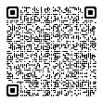
How can a Community Visitor help children and young people?
The functions of a Community Visitor are set out under section 13 and section 56 of the Public Guardian Act 2014 (PGA).
When visiting a visitable home, a Community Visitor may do any of the following:
look around the home and assess its appropriateness for the accommodation of the child under care.
have access to the child under care and talk with the child out of the hearing of other persons at the home.
require a carer staying at the home to give the visitor reasonable help to exercise the visitor’s powers. A person must comply with any such requirement (e.g. a requirement to provide a space to speak with the child/young person in private).
A child or young person living in a visitable site can communicate with a CV—by phone, SMS message or email and they can also request the CV to visit the site, in addition to the CVs regular visits, if they want.
Community Visitor Factsheet

Slide 89
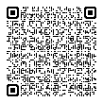
How can a Child Advocate help children and young people?
A Child Advocate will provide individual legal advocacy for a child/young person. The functions of a Child Advocate are set out under section 13 of the Public Guardian Act 2014 (PGA).
Child Advocates are different from CVs. The main difference is all Child Advocates are lawyers who help young people with legal issues.
A Child Advocate can only provide advocacy to children and young people who fit the definition of ‘relevant child’ under section 52 of the PGA – in summary this means the child/young person and their family must have some involvement from Child Safety (e.g., Care Agreement, interim court orders).
Priority legal areas: child protection proceedings, education advocacy, youth justice advocacy and QCAT matters.
Child Advocate Referral Form - Anyone can make a referral for a Child Advocate including foster or kinship carers of a child in care.
Child Advocate Factsheet

Slide 90
QFKC

